Slide 1


Slide 2
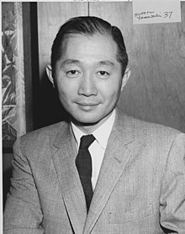
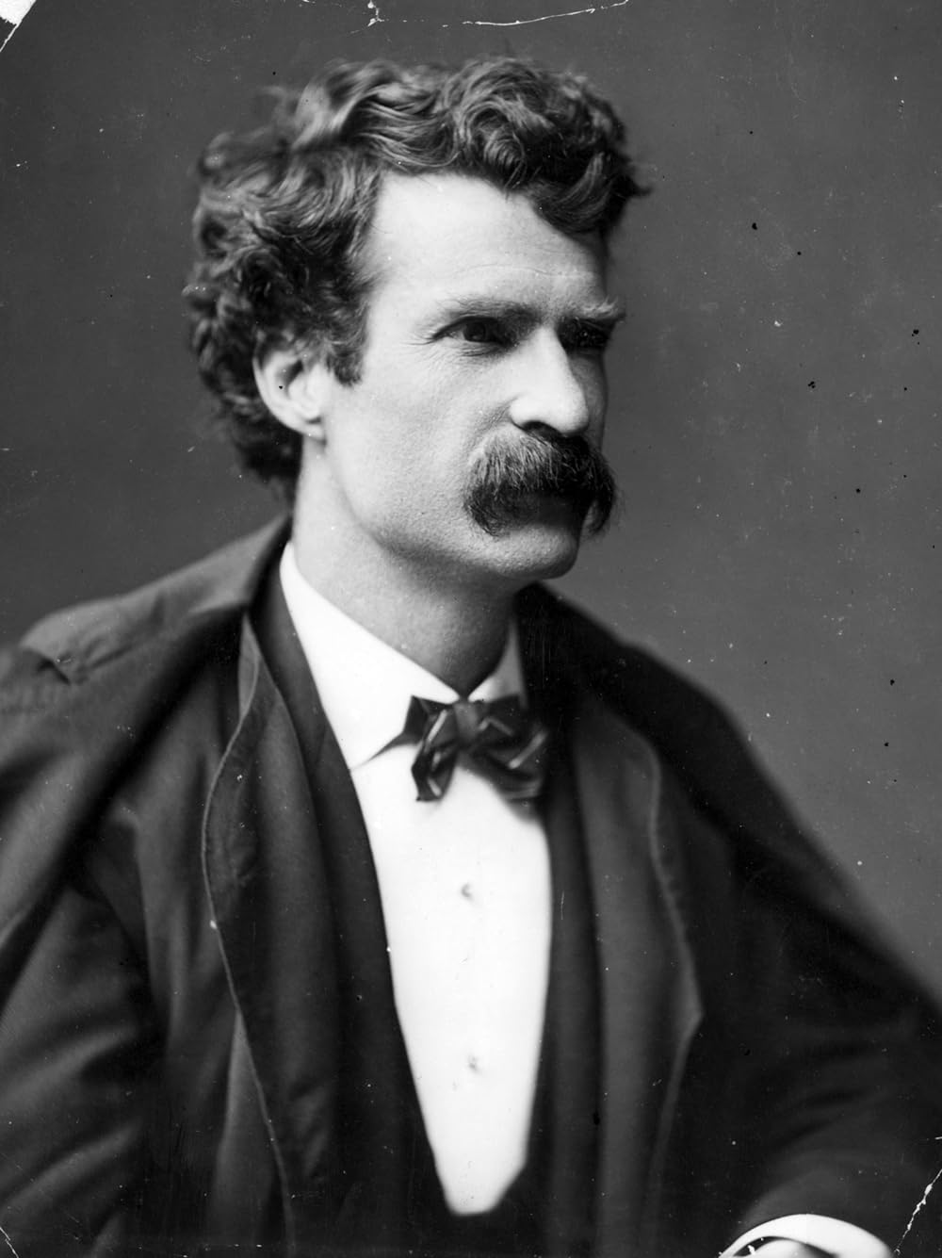
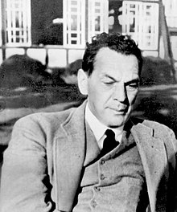
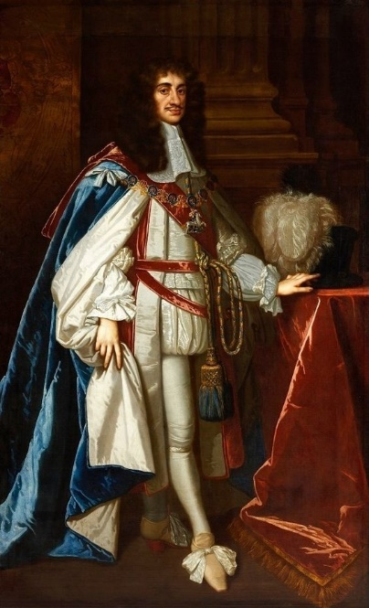
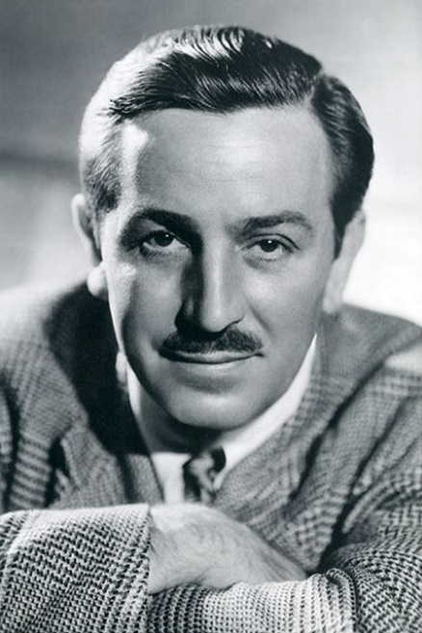
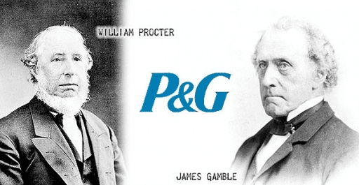
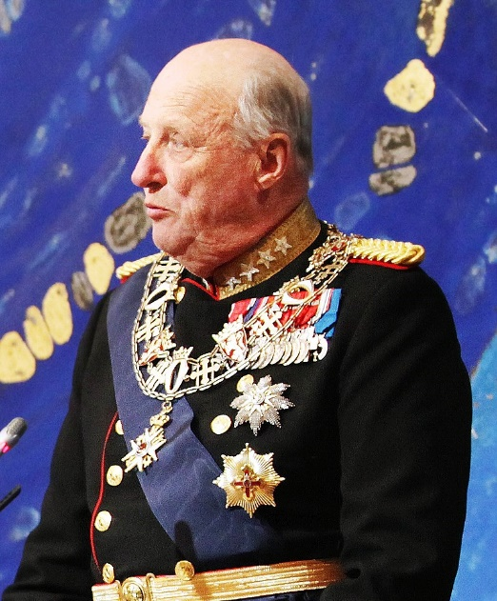
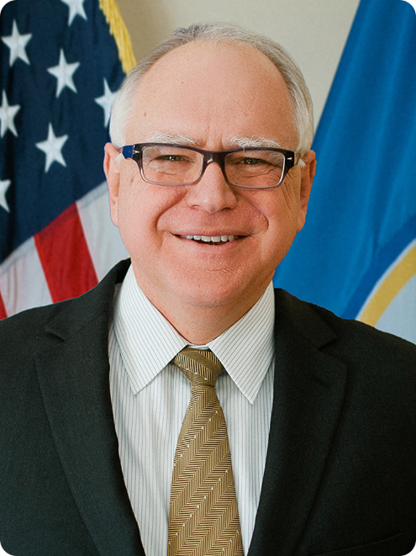
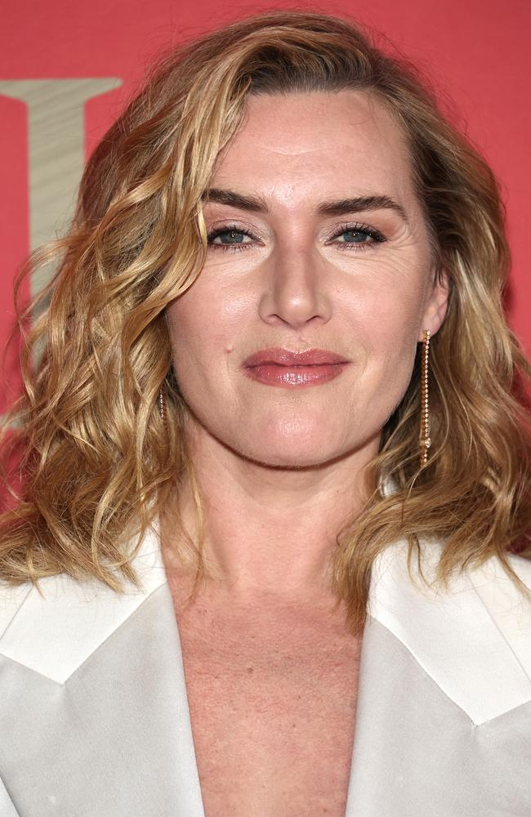
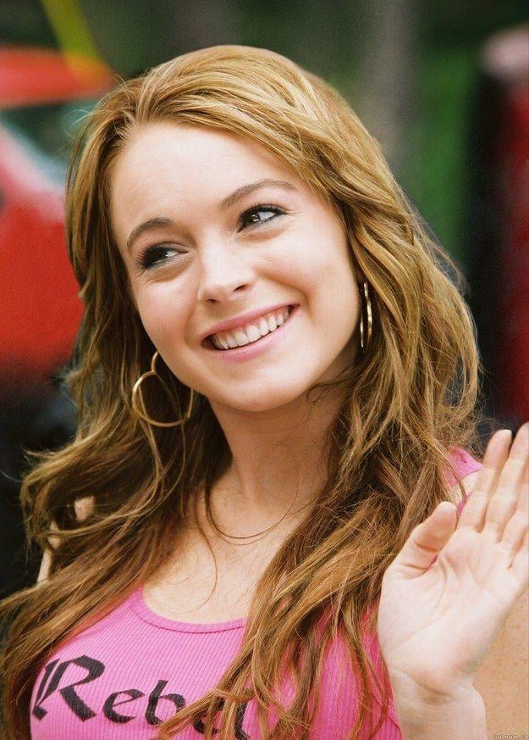
The Black Box

Slide 3
In 1667 England and the Netherlands signed a treaty. According to this treaty they swapped islands. The Netherlands got from England the Indonesian island of Run, the only known place for nutmeg (мускатный орех), while England got another ISLAND from the Dutch. The Dutch soon chopped down all the nutmeg trees on the island of Run and it became useless to them. The English were luckier. Name the ISLAND that the English got.

Slide 4
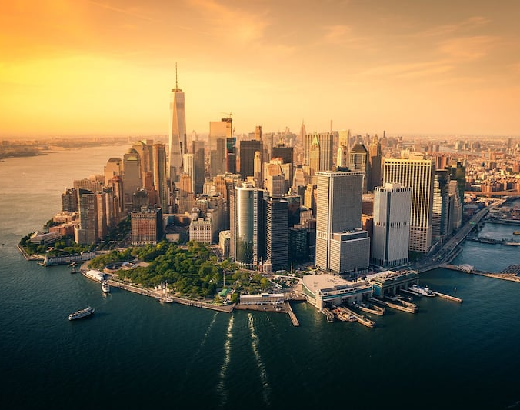
Answer: Manhattan
Commentary: It was on the island of Manhattan where a famous settlement of New Amsterdam appeared. When the English got the island they renamed the settlement from New Amsterdam to New York.Beginning

Slide 5
According to the poll of American children, held at the end of the 20th century, there is one animal that symbolizes America – Mickey Mouse, there is one sign that symbolizes America – Macdonald’s, one vessel (сосуд) – the bottle of Coca Cola, but there are two buildings that symbolize America. Name them.

Slide 6
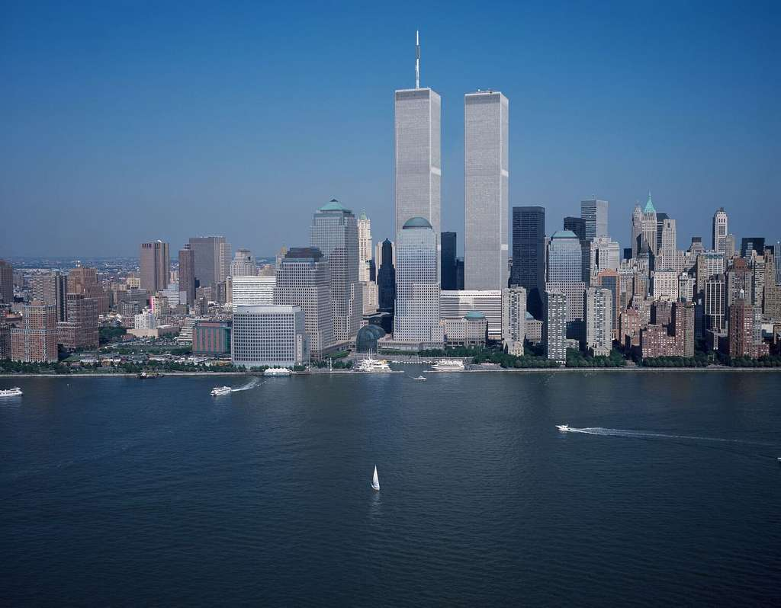
Answer: the Twin Towers of the World Trade Centre in New York City.Beginning

Slide 7
Quite recently in Norway there was a massive catch of THESE BIRDS, which were added to the Red List of Threatened Species in 2018. The birds became prey to literary and cinema popularity. Name THESE BIRDS (the name consists of two words) and the reason why they were caught in big numbers.

Slide 8
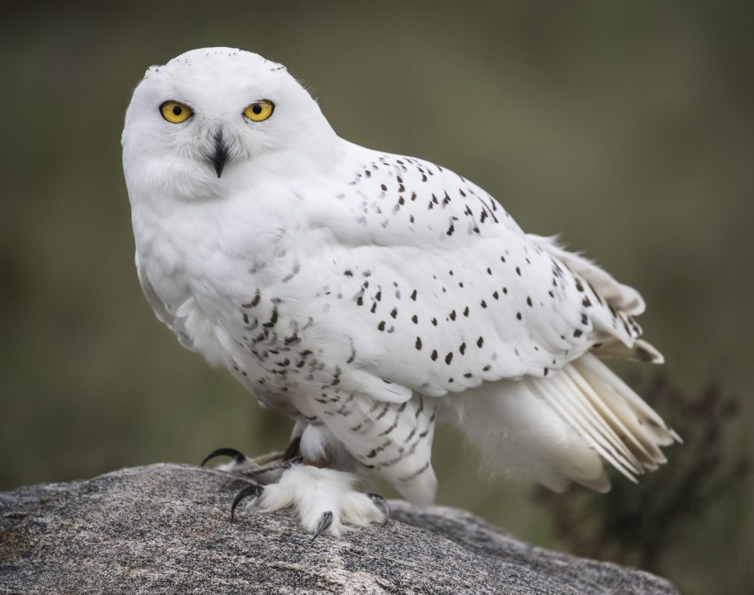
Answer: Snowy owls
Commentary: It became prestigious among the children in Europe to have an owl, similarly to the students of Hogwarts from the books and films about Harry Potter.

Slide 9
In a Finnish city of Tampere there is a famous Spy Museum. It’s interesting that on opening day the number of the bus, driving to the museum, was changed. Name this new THREE-DIGIT NUMBER.

Slide 10
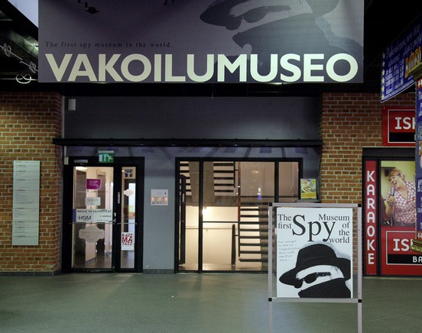
Answer: 007.
Commentary: It is the same as the code number of a famous British spy James Bond.

Slide 11
20-year-old Kate Winslet and 87-year-old Gloria Stuart were nominated to Oscar in 1998. This situation had never occurred in the history of the Academy Award before. Why was it unique?

Slide 12
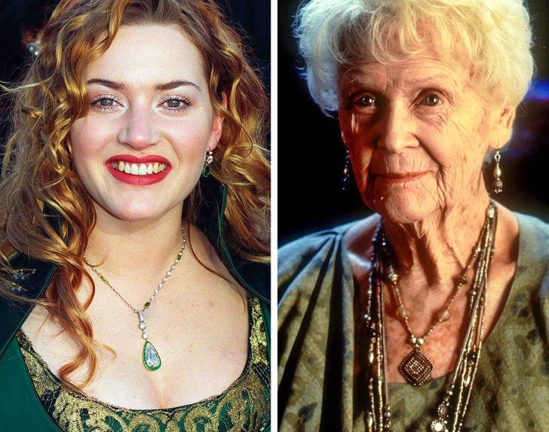
Answer: Both actresses were nominated to Oscar for one and the same role of Rose DeWitt Bukater in the film “Titanic”.

Slide 13
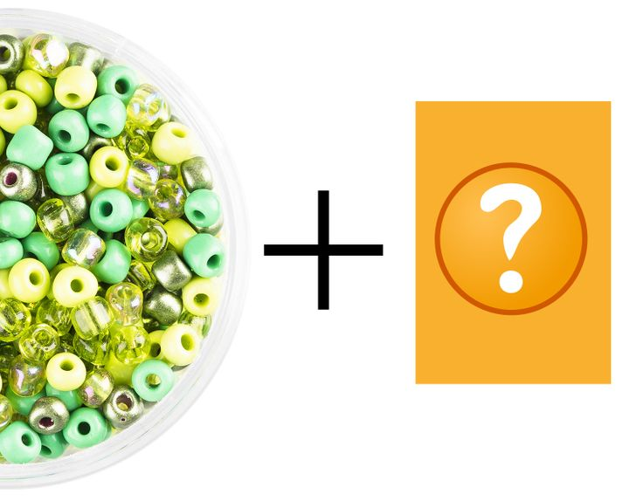
THIS apart from seed beads (бисер) is given to people applying for a job in the assembly departments (cборочный цех) at Asian factories where microchips are manufactured. What is in the black box?

Slide 14

Answer: сhopsticks
Excellent eyesight, speed and motor coordination (координация движений) are highly valued in working with microchips. All these can be checked by asking a candidate for the job to pick up the seed beads with the help of сhopsticks.

Slide 15
When translating the cartoon “Chip 'n Dale: Rescue Rangers” the Mouse was given a different name (Гайка). The original name, meaning a small machine or piece of electronic equipment, was unsuitable because THIS WORD was not widespread in Russia at that time (in 1989). Moreover, to give the Mouse the original name, she must have been turned into a boy. What is the original name of this character?

Slide 16
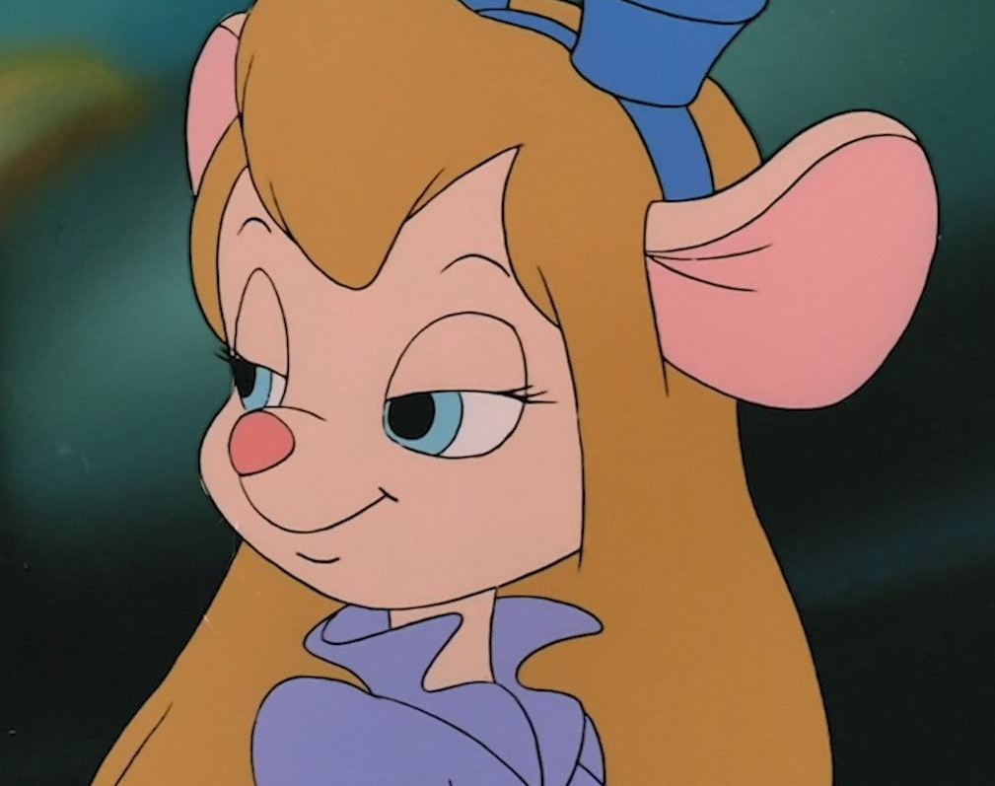
Answer: Gadget

Slide 17
In one TV commercial a CERTAIN BIRD delivered some products of a famous company, Procter & Gamble, into the house. In Japan people were unable to understand this advert. The reason for that was that in Japanese folklore this bird doesn’t perform a certain action demonstrated in the commercial, nor this action is performed by a certain vegetable, but, strangely enough, by giant peaches floating down a river.

Slide 18
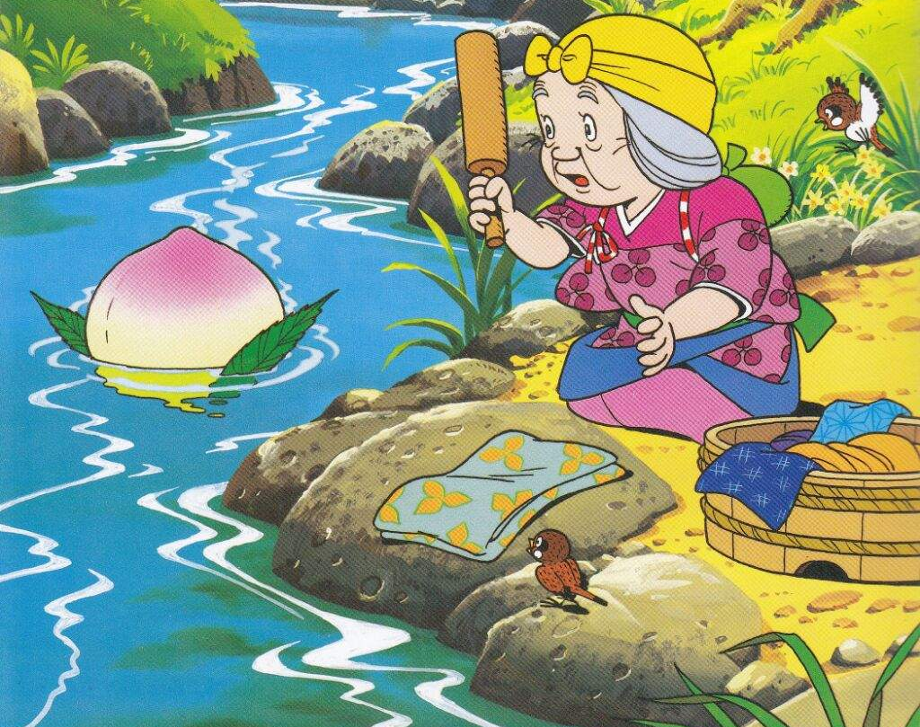

Answer: a stork
Proctor & Gamble’s (P&G) introduced Pampers disposable diapers in Japan in 1976. This failed miserably. In Japanese culture, storks are wild animals, and they wouldn’t deliver babies because they could be dropped in flight and killed. In Japanese folklore, babies are gently delivered by giant peaches floating down a river. P&G learned this story only after market research into the launch failure. When they changed the imagery to a peach, the product took off.

Slide 19
Minnesota’s nicknames is “The North Star State”. Brightly-coloured uniform of the local football players looks like THIS because the residents of Minnesota are among the few people in the world who can see THIS in real life. Name THIS (it consists of two words).

Slide 20
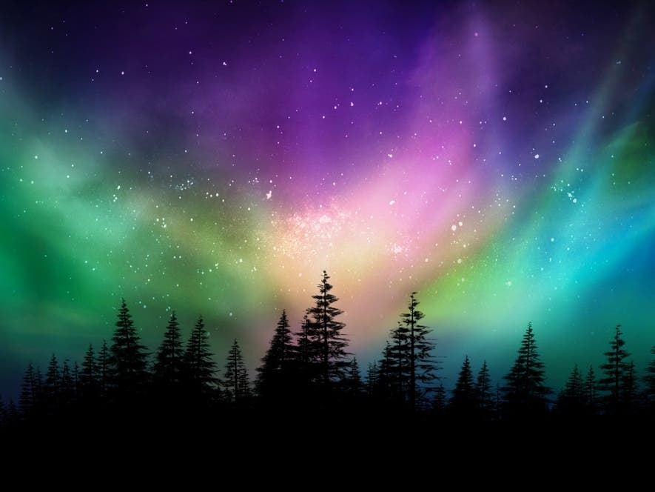
Answer: northern lights
Commentary: the north of Minnesota is famous for its unspoilt and dark night sky, which makes it a perfect place for watching the northern lights.

Slide 21
Samuel Clemens, an American, who had never been to Russia, once stood side by side with Nicolay Korneichukov, a Russian, who had never been to America. Where could such an unbelievable “meeting” have happened? Name a PLACE.

Slide 22

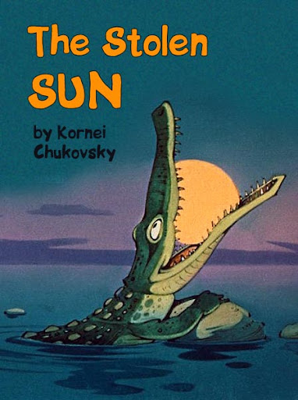
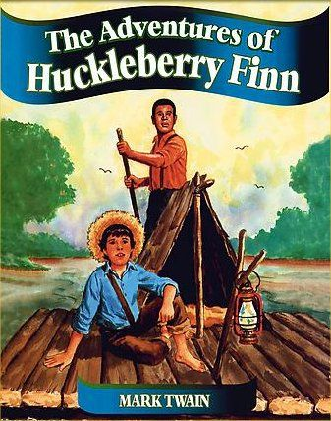
Answer: On a bookshelf / in a bookshop. Both of them were writers. Samuel Clemens was the real name of Mark Twain and Nickolay Korneychukov was the real name of Korney Chukovsky.

Slide 23
The beginning of Lindsay Lohan’s career was truly fairytale. After starring in several films of Disney studio, people started to call Lindsey “another one of THESE”. Officially there are thirteen of THESE. Name THEM (using two words).

Slide 24
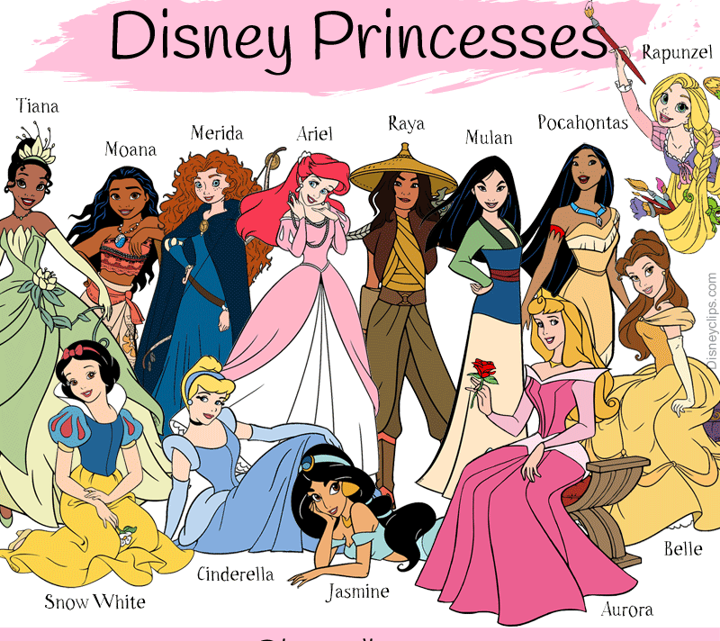
Answer: Disney Princesses.
Officially there are thirteen Disney Princesses.

Slide 25

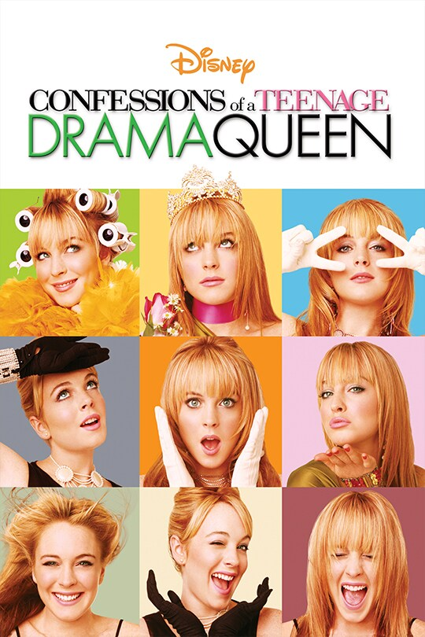

Lindsay appeared in several Disney movies throughout her career: “The Parent Trap” (1998), “Get a Clue” (2002), “Freaky Friday” (2003), “Confessions of a Teenage Drama Queen” (2004), “Herbie: Fully Loaded” (2005), thus earning a title of an Unofficial Disney Princess.

Slide 26
Continue the sequence: love, breath, Rome, estate, column, sense, heaven...

Slide 27
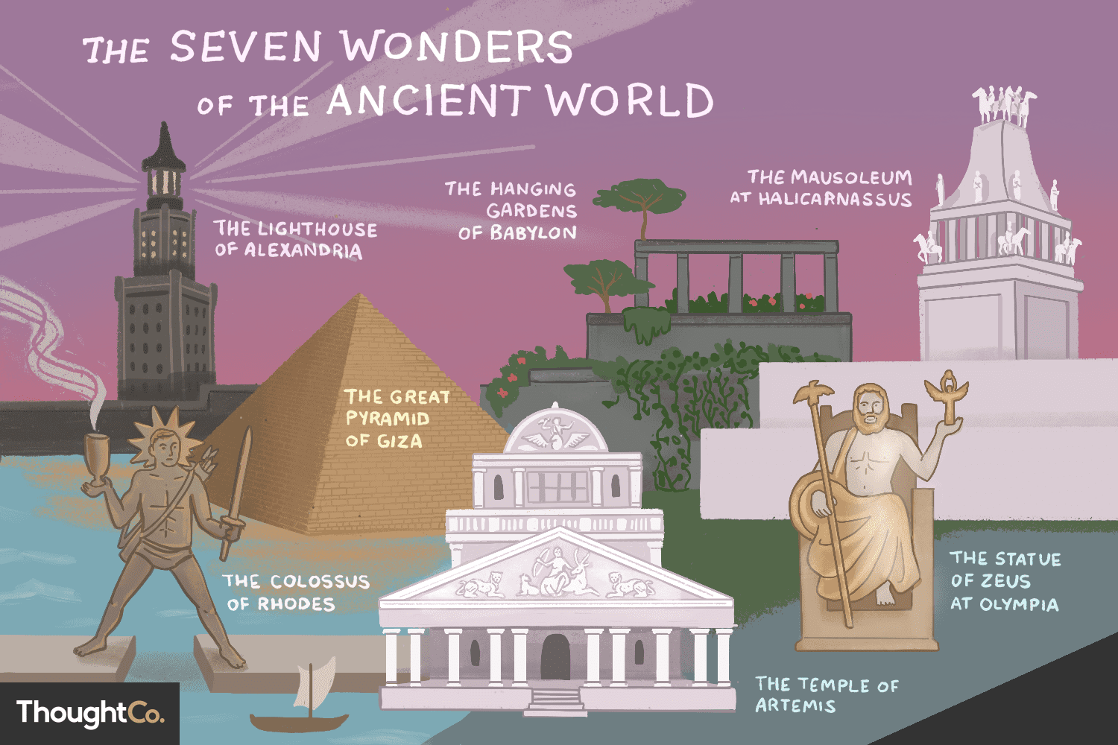
Answer: Wonder
Commentary: The question is based upon popular set expressions: the first love, the second breath, the third Rome, the fourth estate, the fifth column, the sixth sense, the seventh heaven, and the eighth wonder.

